Slide 1
Intelligent Cloud Operations Part 1. Introduction
Definition (Gartner) [AIOps]
AIOps platforms utilize big data, modern machine learning and other advanced analytics technologies to directly and indirectly enhance IT operations (monitoring, automation and service desk) functions with proactive, personal and dynamic insight.
Prof. Jorge Cardoso
E-mail: jorge.cardoso@huawei.com
Intelligent Cloud Operations/SRE Dept.
Munich and Ireland Research Centers
2020
Notes:
Presentation adapted from the previous presentation:
AIOps: Anomaly Detection of Distributed Traces, National University of Ireland, Galway (NUI Galway), 2019.08.20
AIOps-driven Anomaly Detection in microservice architectures, ICT Autonomous Network O&M Conference
2019.06.27, Dublin, Ireland

Slide 2

Intelligent Cloud Operations The emerging field of AIOps
The field of AIOps, also known as Artificial Intelligence for IT Operations, uses advanced technologies to dramatically improve the monitoring, operation, and troubleshooting of distributed systems. Its main premise is that operations can be automated using monitoring data to reduce the workload of operators (e.g., SREs or production engineers). Our current research explores how AIOps – and many related fields such as deep learning, machine learning, distributed traces, graph analysis, time-series analysis, sequence analysis, advanced statistics, NLP and log analysis – can be explored to effectively detect, localize, predict, and remediate failures in large-scale cloud infrastructures (>50 regions and AZs) by analyzing service management data (e.g., distributed traces, logs, events, alerts, metrics). In particular, this talk will describe how a particular monitoring data structure, called distributed traces, can be analyzed using deep learning to identify anomalies in its spans. This capability empowers operators to quickly identify which components of a distributed system are faulty.
Planet/large-scale Distributed systems and cloud computing
Distributed traces, logs, events, alerts, metrics, ….
Big Data platforms with Kubernetes, Hadoop, Spark, Flink, …
Deep Learning, machine learning, data mining, advanced statistics, time-series analysis, NLP, ….
Detect, localize, predict, and remediate failures in infrastructures
Dr. Jorge Cardoso is Chief Architect for Planet-scale AIOps at Huawei’s Ireland and Munich Research Centers. Previously he worked for several major companies such as SAP Research (Germany) on the Internet of Services and the Boeing Company in Seattle (USA) on Enterprise Application Integration. He previously gave lectures at the Karlsruhe Institute of Technology (Germany), University of Georgia (USA), University of Coimbra and University of Madeira (Portugal). His current research involves the development of the next generation of AIOps platforms, Cloud Operations and Analytics tools driven by AI, Cloud Reliability and Resilience, and High Performance Business Process Management systems. He has a Ph.D. in Computer Science from the University of Georgia (USA).
Interests: AIOps, Service Reliability Engineering, Cloud Computing, Distributed Systems, Business Process Management
GitHub | Slideshare.net | GoogleScholar

Slide 3
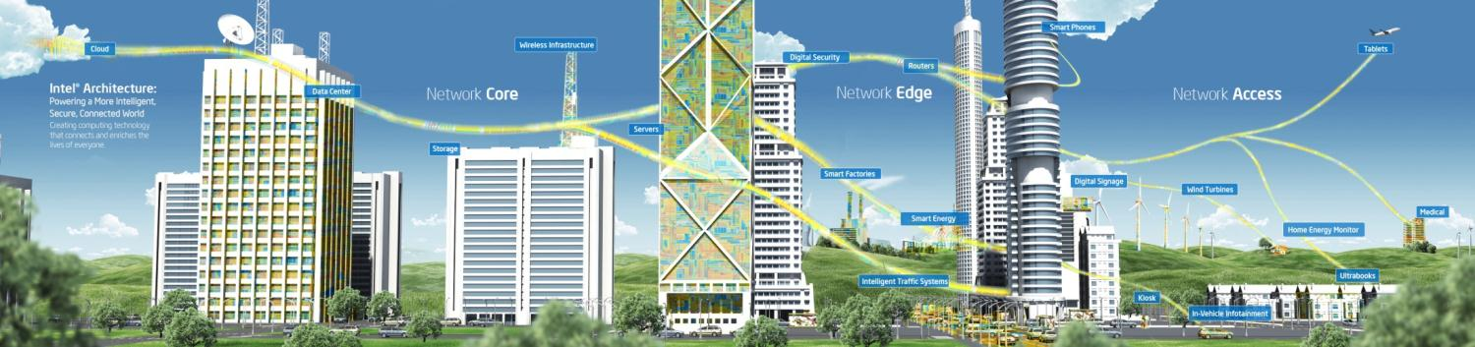

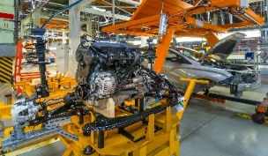
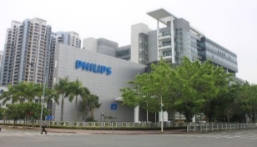

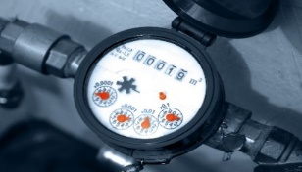


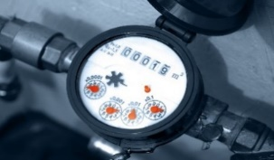
Operations and Maintenance Global Trends
The cloud has evolved from a disruptor to an obvious solution for enterprise IT. However, the increasing complexity of public, private, edge, and hybrid cloud environments presents new challenges for cost-efficient operations and maintenance (O&M) tasks
Networking
IoT Infrastructure
Radio Access Network
Virtual CPE
Core Networks
Network Appliances
Content Delivery Networks
Mobile Edge Computing
Energy
Manufacturing
Healthcare
Smart Cities/Buildings
East Environment Energy
Geely
PHILIPS Medical

Slide 4

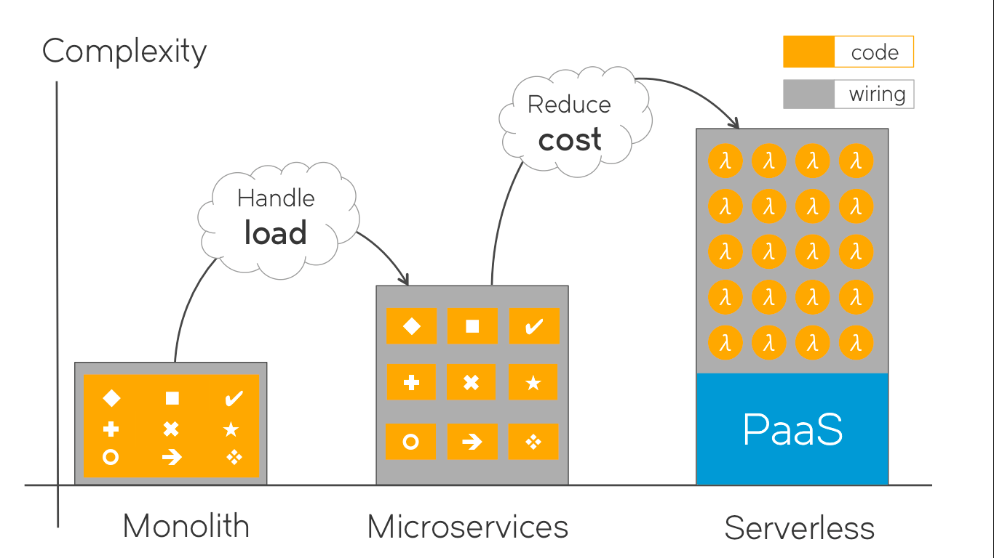
Underlying Problem Increasing Complexity of Distributed Systems
An hypothetical planet-scale Cloud
Every year the management of IT O&M is more complex
Digitalization with cloud, mobile, and edge
Large-scale microservice and serverless systems
Increase in IT size, and event/alert volumes
SLA guarantee for critical applications
Nano/microservices break existing monitoring tools
Planet-scale Cloud
Data Center 10
Data Center 2
Server 1
Data Center ..
Server 2
Server ..
Server 20.000
Socket 1
Core 1
VM 1
VM 2
VM 3
Core ..
Core 16
Data Center 1
Socket 2
Core 2
However, existing O&M tools still rely on old approaches which involve manual rule configuration, averages and std, and data wrangling to manage physical assets
Huawei Cloud is an example of a planet-scale complex system:
40 availability zones, 23 geographical regions
(Germany, France, South/Central America, Hong Kong and Russia to Thailand and South Africa)
Microservices/serverless add complexity to communications between services making systems far more difficult to maintain and troubleshoot. With a monolith application, when there is a problem, only one product owner needs to be contacted.
20M VMs (3 VM/core), billion metrics
(for illustrative purpose only)

Slide 5

Intelligent O&M Change Management
70% of outages are due to changes in a live system
Change is the management of risks.
Automation is the key!
Decoupling. Implementing progressive rollouts
Fast positioning and isolation. Quickly and accurately detecting problems
Rollback. Rolling back changes safely when problems arise

Slide 6


























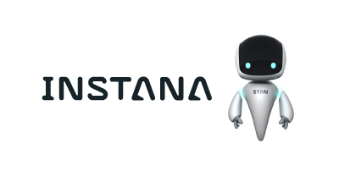


Intelligent O&M Commercial Solutions
< 2000
2010
2012
2015
2020
Centralized
Processing
Distributed Processing
Services
all-in-one
AI-based Platforms
AIOps Platforms
Phase 1.0
Small data: MB/GB
Manual operation with Unix tools (ping, traceroute, tcpdump)
Centralized monitoring tools
Individual monitoring of servers
Phase 2.0
Big Data processing: TB/PB
Integration of distributed processing platforms
Monitoring of SOA
Visualization
Phase 3.0
Automation
Monitoring as a service
Cloud / on premise
Servers, services
Hadoop, analytics
Phase 4.0
Enhance existing solutions with AI
Simple AI algorithms clustering, regressions, outlier detection
Phase 5.0
Make AI actionable
Exploit knowledge graphs
Fault prediction
Recommendations for fault handling
Automated recovery
Self-service
Customer service
Deployment analysis
Target availability, efficiency, and cost

Slide 7
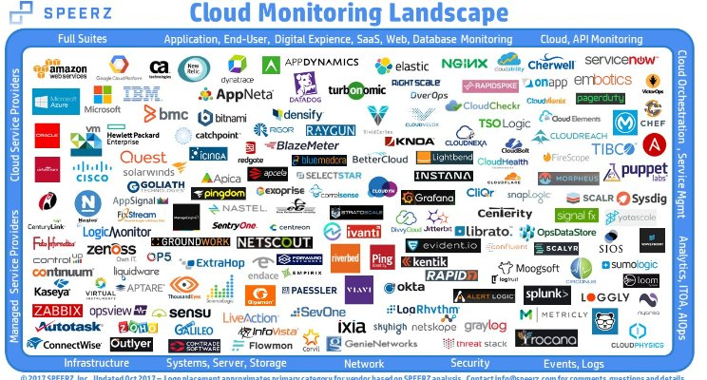
Intelligent O&M Commercial Solutions

Slide 8
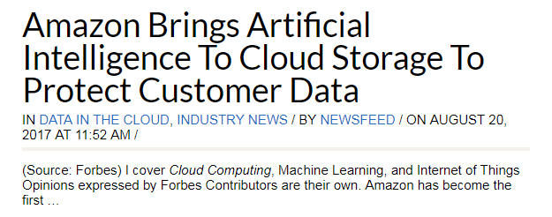
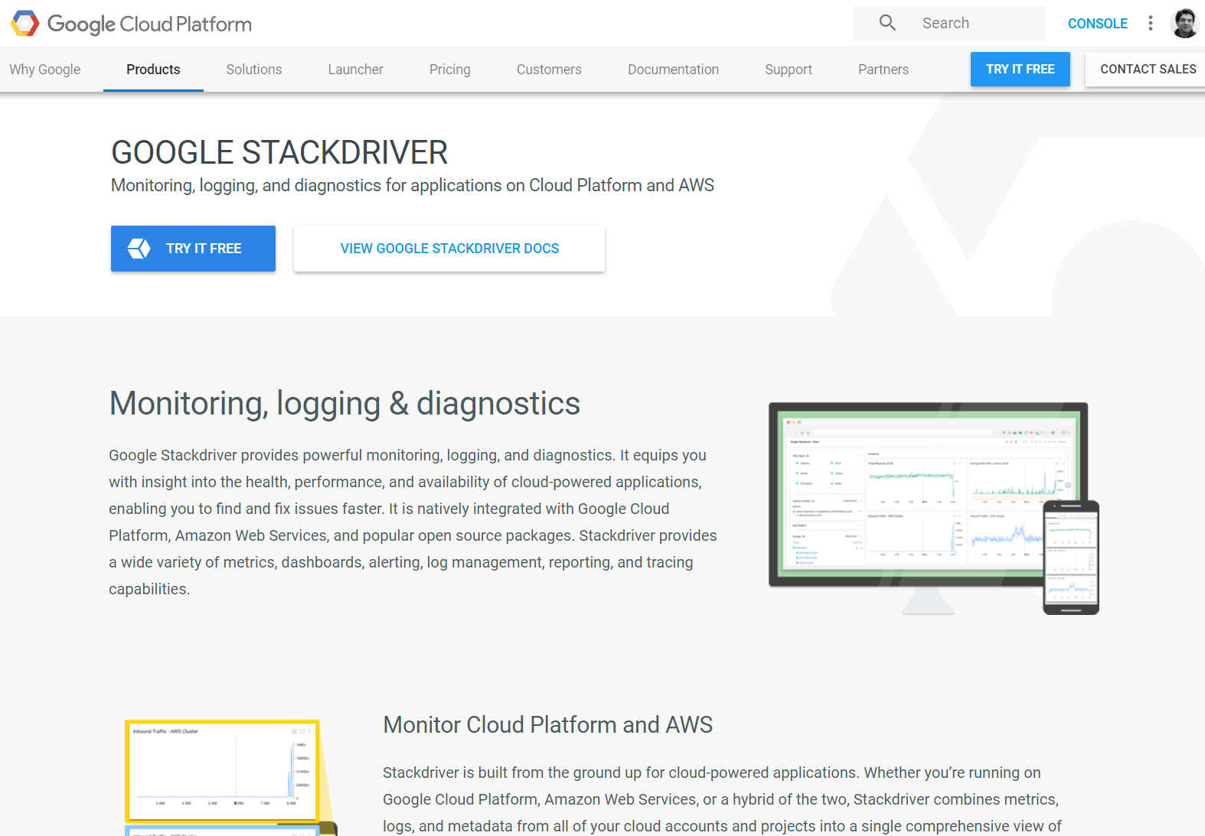
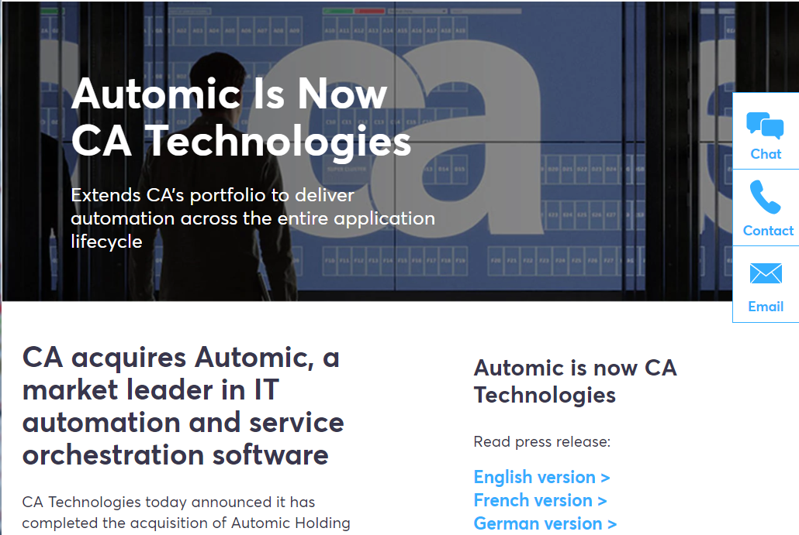
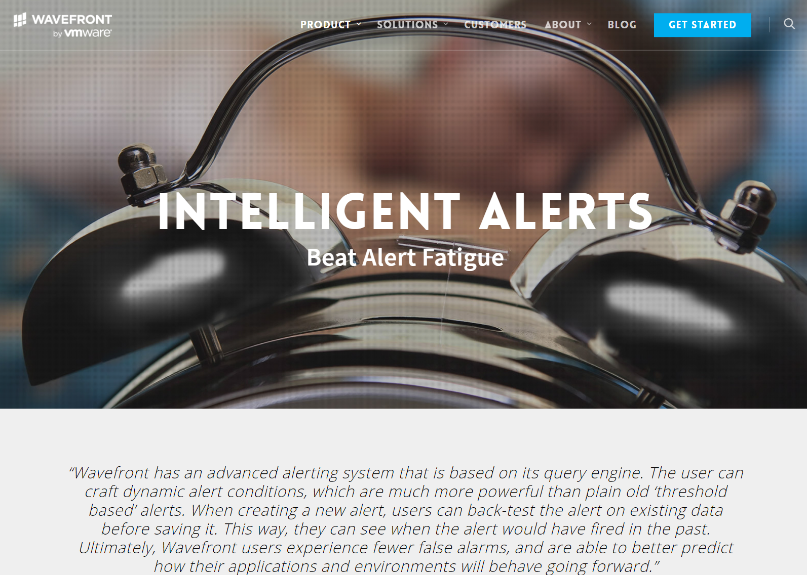
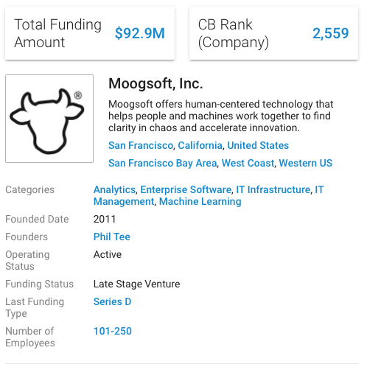
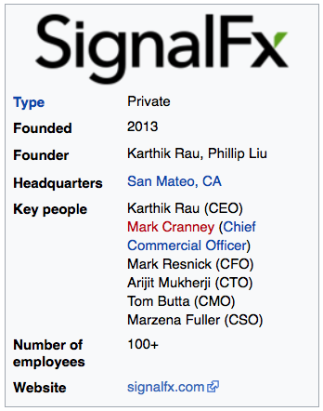
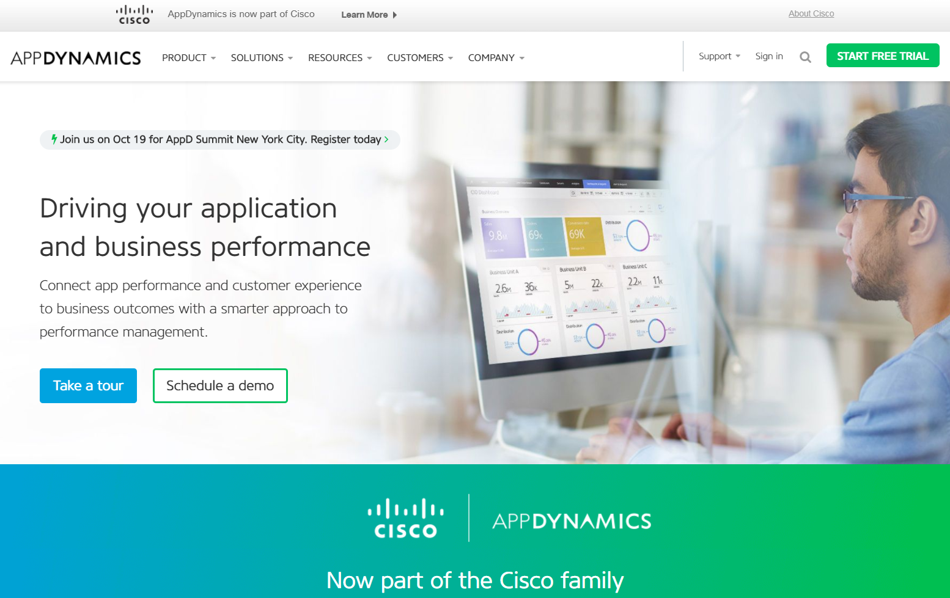
Industry Trends Bringing AI to O&M
The market is seeing interesting mergers and acquisitions by important vendors
Cloud providers are also emerging as ITIM tool providers purely for their IaaS offerings At the moment, these tools have visibility limited to the cloud providers' own environment
Nonetheless, they are valuable assets which can also be offered to external customers
VMware’s acquisition of Wavefront is interesting from an analytics perspective
ScienceLogic has acquired AppFirst, enabling it to acquire granular application metrics
CISCO has acquired AppDynamics and Perspica, enabling it to acquire rea-time monitoring and AI
CA Technologies’ acquisition of Automic brings in an additional automation technology to its existing portfolio
Spinoff of Hewlett Packard Enterprise’s (HPE's) software business to Micro Focus
Amazon AWS
CA acquired Automic (2017)
VMware acquired Wavefront (2017)
Google acquired
StackDriver (2014)
Cisco acquired AppDynamics (2017)
Cisco acquired Perspica for ML (Oct 2017)
Startup in the field of AIOps

Slide 9

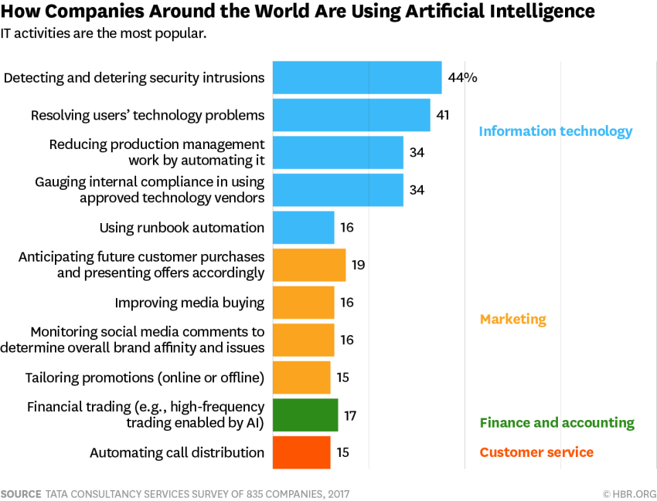
Industry Trends Bringing AI to O&M
O&M Activities
System monitoring and 24x7 technical support, Tier 1-3 support
Troubleshooting and resolution of operational issues
Backup, restoration, archival services
Update, distribution and release of software
Change, capacity, and configuration management
…
“We began applying machine learning two years ago (2016) to operate our data centers more efficiently… over the past few months, DeepMind researchers began working with Google’s data center team to significantly improve the system’s utility. Using neural networks trained on different operating scenarios and parameters, we created a more efficient and adaptive framework to understand data center dynamics and optimize efficiency.” Eric Schmidt, Dec. 2018
“Virtyt Koshi, the EMEA general manager for virtualization vendor Mavenir, reckons Google is able to run all of its data centers in the Asia-Pacific with only about 30 people, and that a telco would typically have about 3,000 employees to manage infrastructure across the same area."
Reducing O&M Costs
Google: 30 operators
Others: 3000 operators
Early indicators Moogsoft AIOps, Amazon EC2 Predictive Scaling, Azure VM resiliency,
Amazon S3 Intelligent Tiering
38.4% of organizations take more than 30 minutes to resolve IT incidents that impact consumer-facing services (PagerDuty)
Harvard Business Review
https://www.lightreading.com/automation/google-has-intent-to-cut-humans-out-of-network/d/d-id/742158
https://www.lightreading.com/automation/automation-is-about-job-cuts---lr-poll/d/d-id/741989
https://www.lightreading.com/automation/the-zero-person-network-operations-center-is-here-(in-finland)/d/d-id/741695

Slide 10
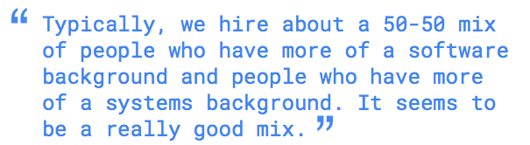
Site Reliability Engineering Planet-scale Reliability
Reliability is the most important feature of a product. SRE is responsible for it …
Product readiness assessment
Setup quantified SLO
Run Err Budget
Self-constraint, balanced Dev/Ops
Pay attention to the facts and stop quarrelling
Four golden signals
Altering from time-series
Eliminating Toil
Implement monitoring and develop handling processes
Diagnosis, analysis, and detailed data
Define contextual, customer-focused SLOs
Humans add latency
70% of outages due to changes in a live system
50% software engineer / 50% system engineer
Load slows down systems
Elite forces, focusing on high-ROI work
Regular review meetings
Corporate email list sharing
Guarantee that there are few problems
It's either a problem or a quick recovery
The recovery tool is designed in the early stage of the process
Addressing cascading failures
Take turns to monitor and document solutions
Distributed consensus for reliability
Training through brain games
Perform regular drills in the environment
Automation: all employees can be involved in the work
Continuous review and optimization

Slide 11
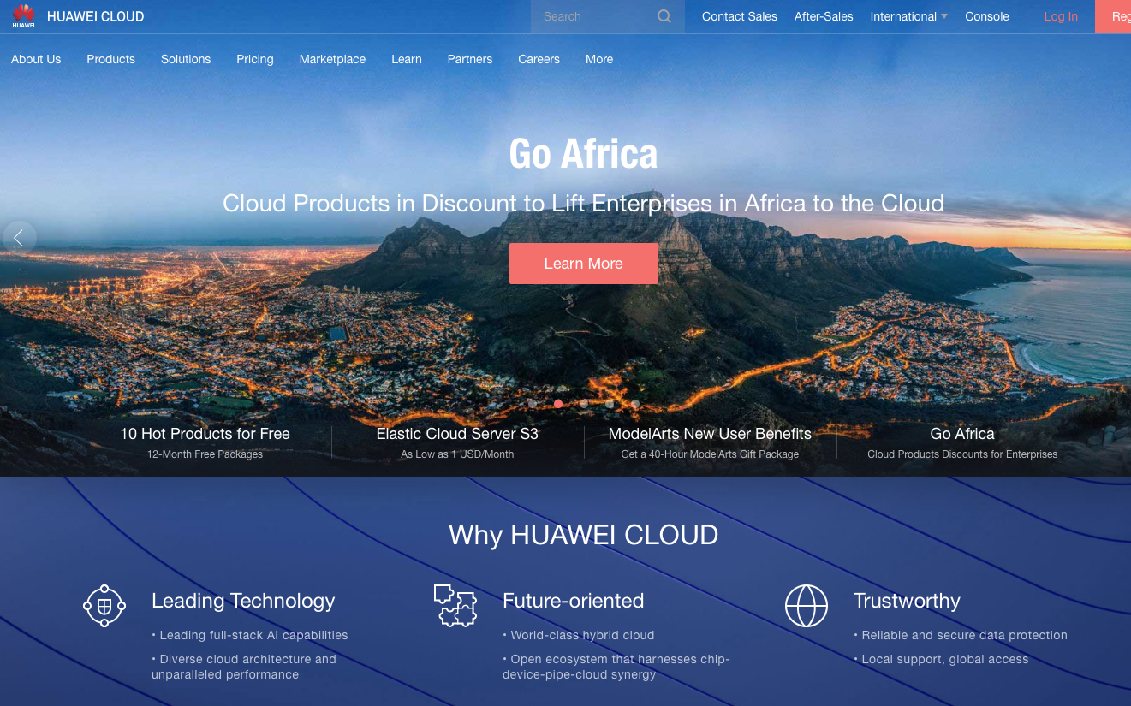
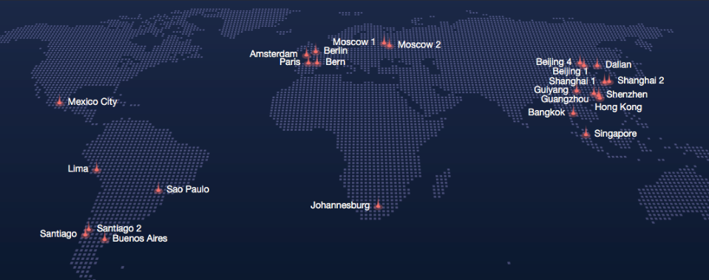
Huawei Cloud Planet-scale Landscape
… a few numbers…
worldwide, Huawei Cloud has 44 availability zones across 23 regions (June 2019)
more than 180 cloud services and 180 solutions for a wide range of sectors
Costumers include European Organization for Nuclear Research (CERN), PSA Group, Shenzhen Airport, Port of Tianjin, …
Notes:
http://tagitnews.com/en/Article/page/huawei-cloud-opens-chile-region-service
Huawei Cloud (2 slides)
Webpage
Regions and AZsCloud
Reliability (1 slide)
(see slides from Reliability workshop in Berlin)
SRE Concept from Google
70% of accidents come from changes in a running system
Huawei Cloud O&M System (5 slide)
Monitoring Capabilities
KPI Indicators
Security
O&M Platform

Slide 12
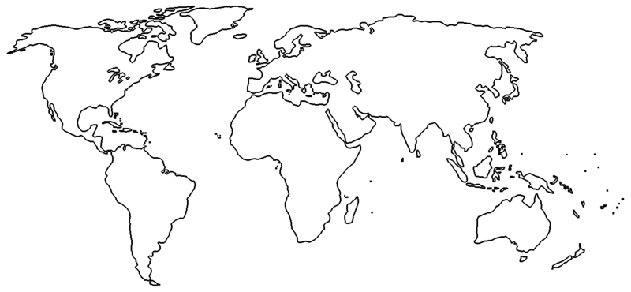



Huawei Cloud Worldwide Coverage
A global cloud network with resources and service teams all over the world
Daqing
France
Netherlands
United States
Spain
Karamay
North China Center
Changchun
Langfang
Beijing
Ulanqab
United States
Guizhou
Suzhou
Neumann
Beijing
Dalian
Mexico
Africa region
Lv Liang
Langfang
Dongli
Tsingtao
Colombia
Singapore
Qingyang
Xinxiang
Yenan
Jining
Yancheng
Peru
Brazil
Xiangyang
Xuzhou
East China Center
Ziyang
Suzhou
Shanghai
Meishan
Fuling
Shangrao
Chile
Luzhou
Yongzhou
Longyan
Huzhou
Argentina
Southwest Guizhou
Zhangzhou
Guilin
Guizhou center
Shenzhen
Yuxi
Qinzhou
Yunfu
Guangzhou
Hong Kong
South China Center
2015.07
2016.02
2016.06
2016.09
2017.03
Overseas public cloud + domestic joint operation cloud + domestic public cloud
Compliance with local laws and regulations, facilitating global expansion of enterprise business
Three regional centers in China and more than 30 city nodes
Notes:
http://tagitnews.com/en/Article/page/huawei-cloud-opens-chile-region-service
Huawei Cloud (2 slides)
Webpage
Regions and AZsCloud
Reliability (1 slide)
(see slides from Reliability workshop in Berlin)
SRE Concept from Google
70% of accidents come from changes in a running system
Huawei Cloud O&M System (5 slide)
Monitoring Capabilities
KPI Indicators
Security
O&M Platform

Slide 13
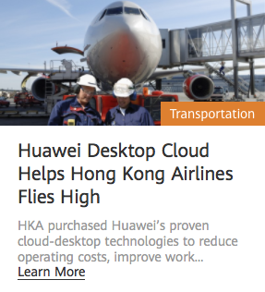
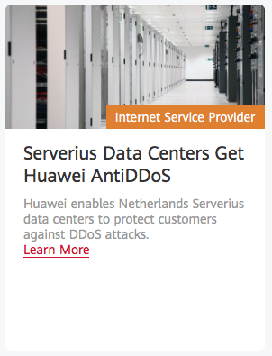
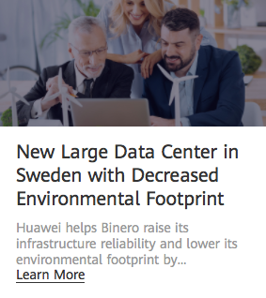
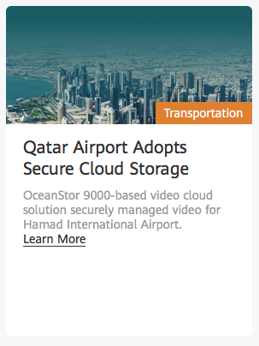
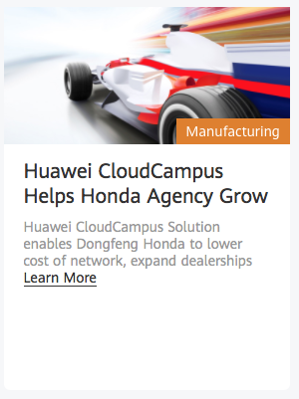
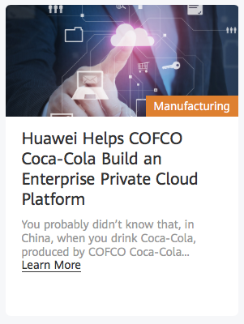
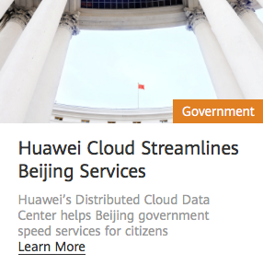
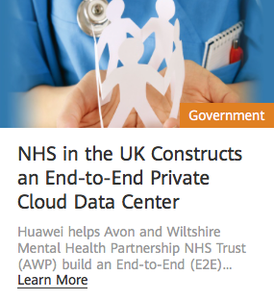

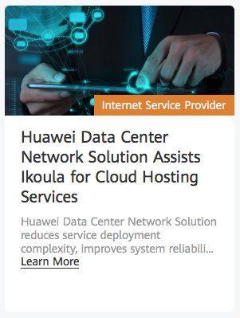
Huawei Cloud Success Stories
Notes:
http://tagitnews.com/en/Article/page/huawei-cloud-opens-chile-region-service

Slide 14
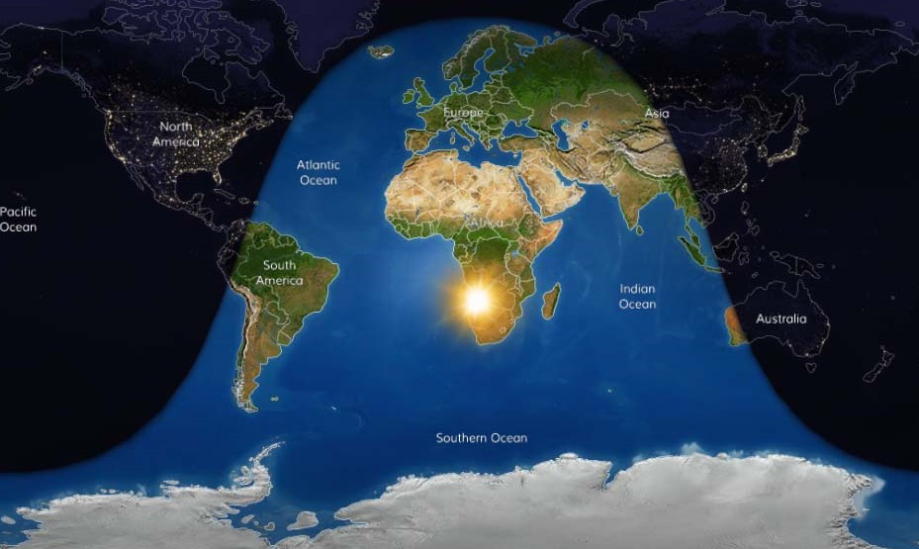

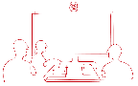
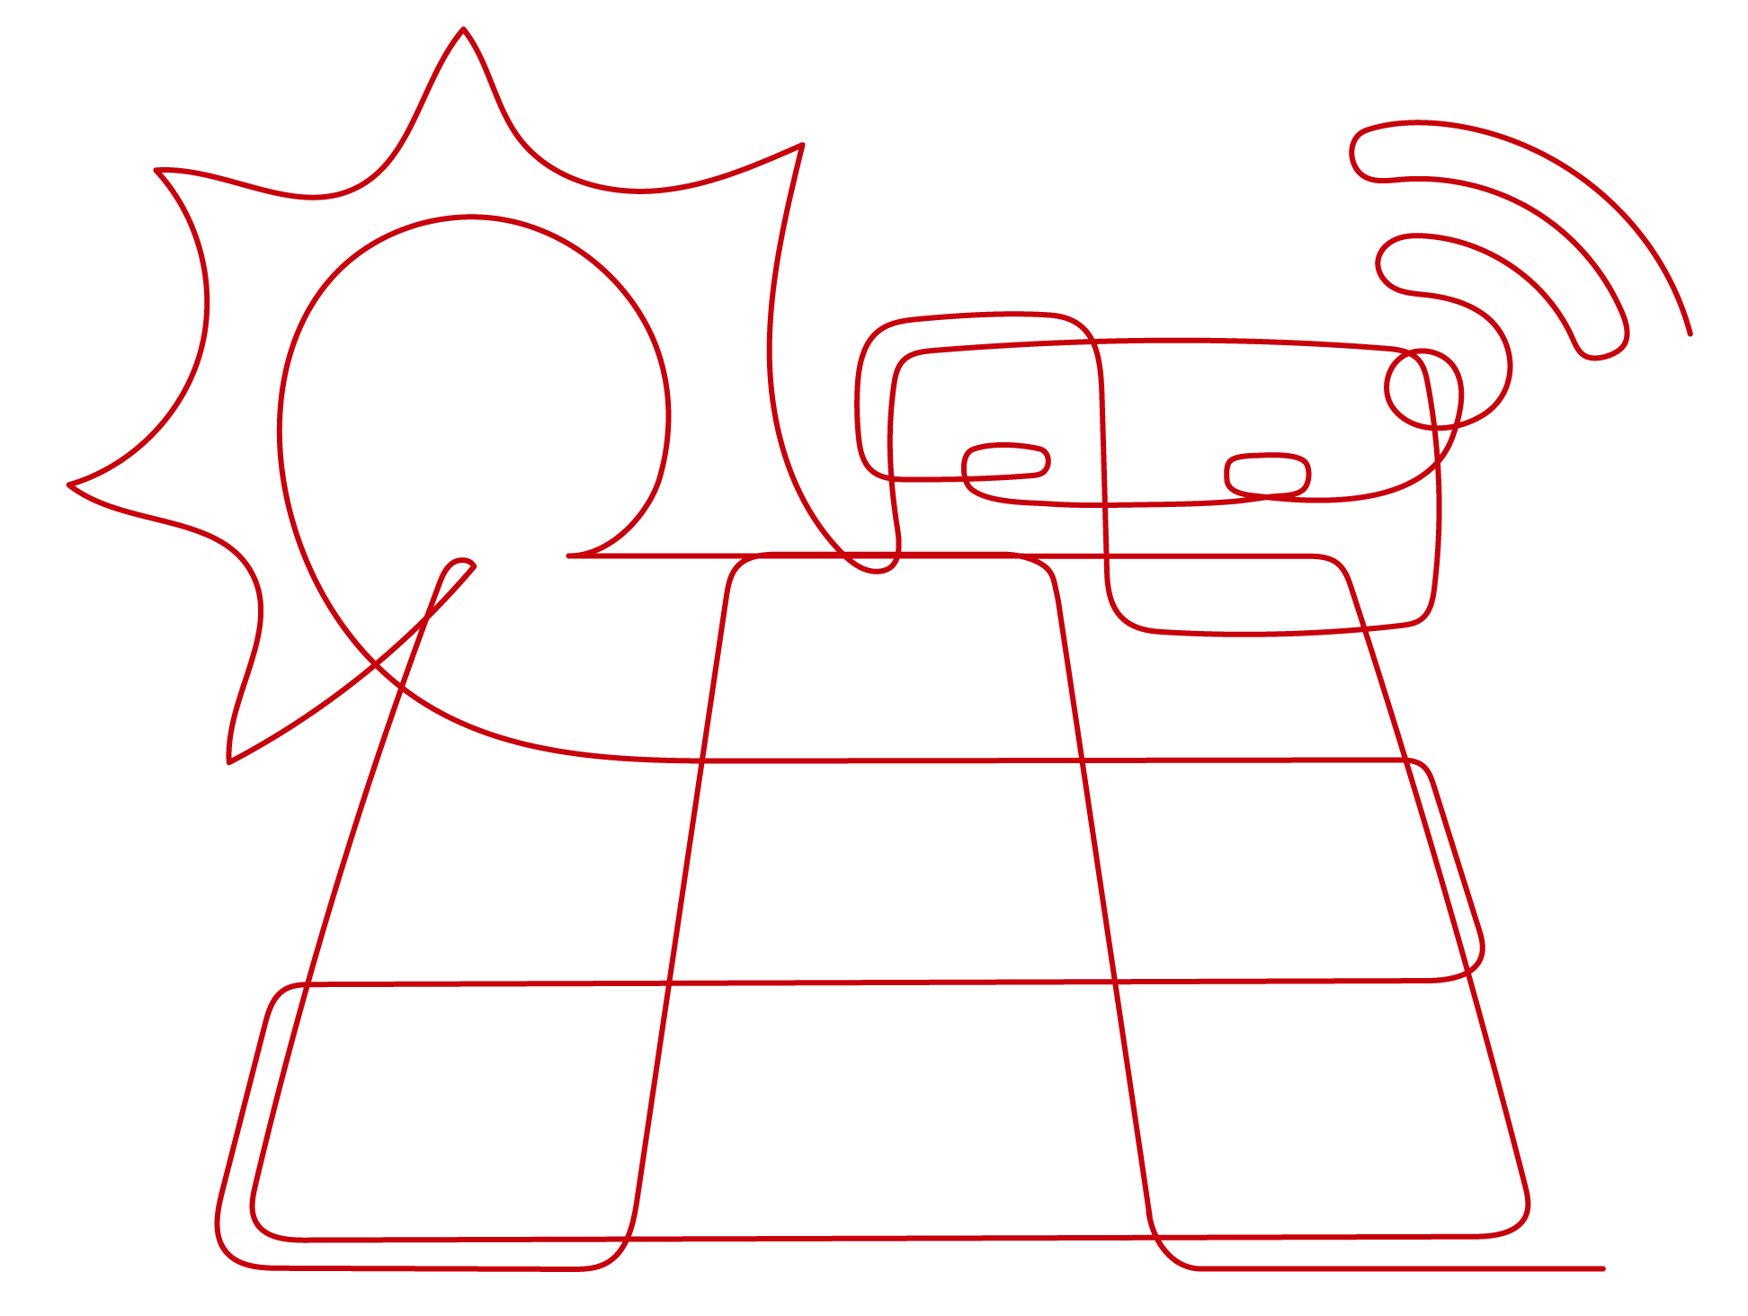

Site Reliability Engineering Huawei Global O&M Competence Center
Xi'an
Beijing/Langfang
IaaS capability center
PaaS capability center
SaaS capability center
DBA/ Big Data Competence Center
Hardware Competence Center
7*24 Call Center
7*24 monitoring center
Security Competence Center
DR capability center
Shenzhen/Dongguan
Shanghai/Hangzhou
O&M architecture capability center
O&M management center
Customer Support Center
Virtualized network capability center
O&M Automation Competence Center
Budapest
Mexico (in constr.)
Europe O&M center
America O&M center
Notes:
http://tagitnews.com/en/Article/page/huawei-cloud-opens-chile-region-service

Slide 15
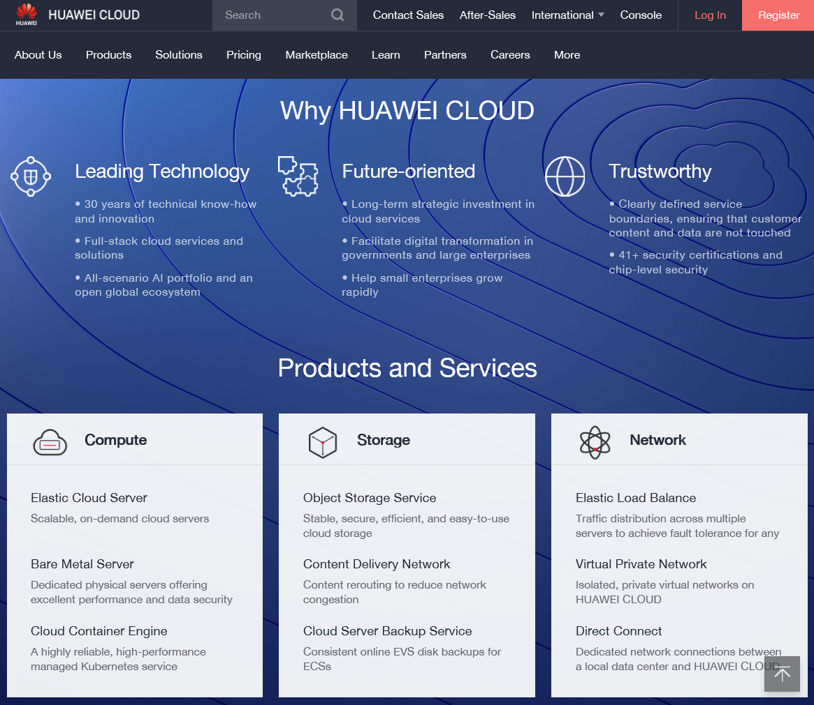
AIOps @ Huawei Cloud Troubleshooting Scenarios
HC System’s Components
OBS. Object Storage Service is a stable, secure, efficient, cloud storage service
EVS. Elastic Volume Service offers scalable block storage for servers
VPC. Virtual Private Cloud enables to create private, isolated virtual networks
ECS. Elastic Cloud Server is a cloud server that provides scalable, on-demand computing resources
Troubleshooting Scenarios
Response Time Analysis
A service started responding to requests more slowly than normal
The change happened suddenly as a consequence of regression in the latest deployment
System Load
The demand placed on the system, e.g., REST API requests per second, increase since yesterday
Error Analysis
The rate of requests that fail -- either explicitly (HTTP 5xx) or implicitly (HTTP 2xx with wrong content) -- is increasing slowly, but steadily
System Saturation
The resources (e.g., memory, I/O, disk) used by key controller services is rapidly reaching threshold levels
https://intl.huaweicloud.com/

Slide 16
AIOps @ Huawei Cloud Troubleshooting Tasks
iForesight is an intelligent new tool aimed at SRE cloud maintenance teams. It enables them to quickly detect anomalies thanks to the use of artificial intelligence when cloud services are slow or unresponsive.
Reference architecture for AIOps platforms
Business
Operators
DevOps
Developers
O&M Troubleshooting Tasks
Visualization, Exploration, Reporting
Anomaly Detection
Fault Diagnosis
Fault Prediction
Fault Recovery
Analytical Data Store
Stability Analysis: Machine Learning and Analytics
Anomaly detection. Determine what constitutes normal system behavior, and then to discern departures from that normal system behavior
Fault diagnosis (root cause analysis). Identify links of dependency that represent causal relationships to discover the true source of an anomaly
Fault Prediction. Use of historical or streaming data to predict incidents with varying degrees of probability
Fault recovery (Incident Remediation). Explore how decision support systems can manage and select recovery processes to repair failed systems
Fault Prediction
Fault Diagnosis
Topology Analysis
Anomaly Detection
Fault Recovery
Fault Prevention
Batch Processing
Stream Processing
Time Series Registry
Historical Data Storage
Real-time Ingestion
Distribution Layer
Data Source Connectors
Metrics
Tracing
App Logs
Events
Topology

Slide 17
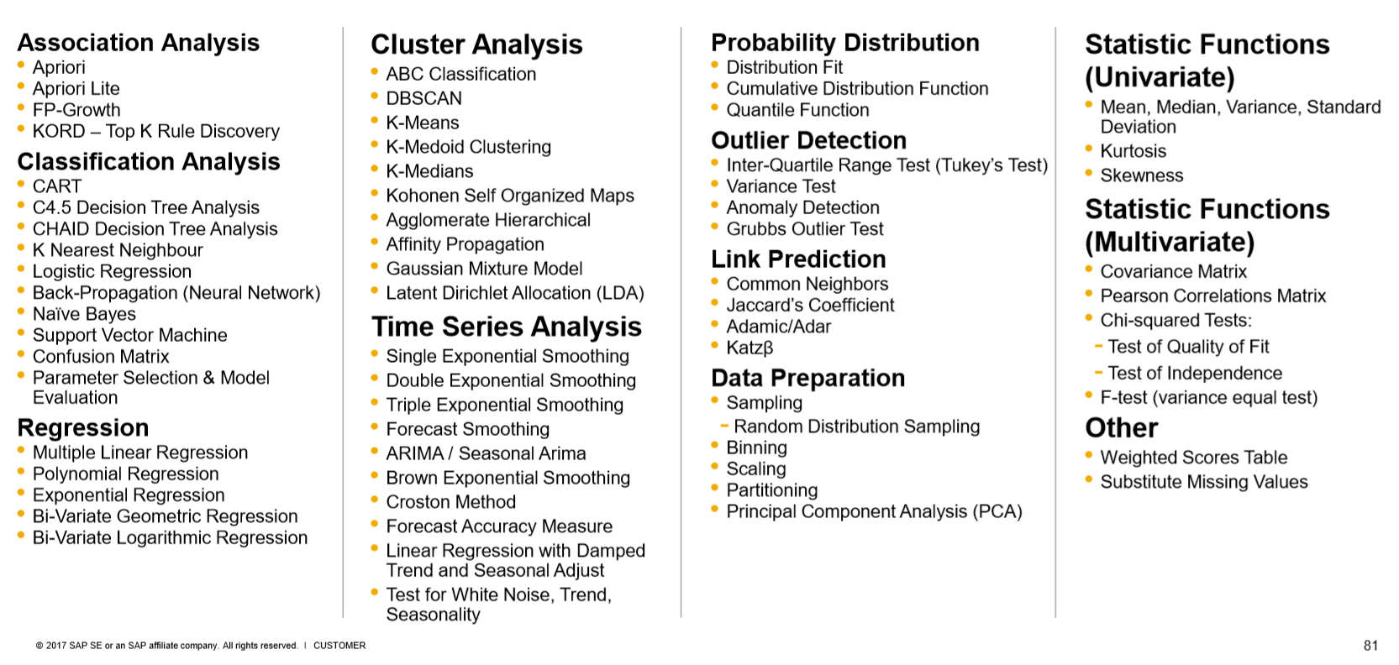
SAP HANA In-Memory Predictive Analytics Typical toolbox of algorithms for AIOps
Generic algorithms are building blocks for AIOps, but they rarely work as ready to use solutions
Their applicability is often illustrated with toy examples which do not hold in production
Algorithms need to be wisely combined, modified, complemented to build new techniques (and methods) which are useful for O&M for a particular context
e.g., unstable systems, high noise-signal ratio, multi-modal
https://www.slideshare.net/SAPTechnology/hana-sps08-newpredictiveanalysislibrary

Slide 18

Challenge: Planet Scale Monitoring Data Generated
An hypothetical planet-scale Cloud
* 10 data centers (~10MW of power)
* 20.000 server (500 watts)
* 2 sockets * 16 cores
* 3 VMs
= 200K servers
≈ 20M VMs
Infrastructure and Services
200K servers
* 75 (CPU, MEM, disk, net, processes, etc.)
+ 25 (counters, gauges, trace, log, metrics)
= 200K * 100 = 20M time-series
VMs
20M VMs
* 75 (CPU, MEM, disk, net, processes, etc.)
+ 25 (counters, gauges, trace, log, metrics)
≈ 20M * 100 = 2B time-series
Traffic
> 100 bytes per observation
≈ 20M * 100 = 2GB / sec ≈ 200TB / day (≈ *100K)
≈ 2B * 100 = 200GB / sec ≈ 2PB / day (≈ *100K)
HC Cloud
Data Center 10
Data Center 2
Server 1
Data Center ..
Server 2
Server ..
Server 20.000
Socket 1
Core 1
VM 1
VM 2
VM 3
Core ..
Core 16
Data Center 1
Socket 2
Core 2
Where do metrics come from
REST API, RCP, DB calls latency
Trace latency between events
HTTP error rate, requests
Transaction throughput
VMs/containers CPU, MEM, DISK
Application monitoring data
Facebook’s Canopy generates and processes 1.3 billion traces per day
2BN users/5K/server = 360K servers
≈ 1B * 10KB = 10TB / day

Slide 19
AIOps @ Huawei Cloud Monitoring Data Structures
System’s Components (e.g., compute, storage, network) are monitored and generate various types of data: Logs, Metrics, Traces, Events, Topologies
Logs. Service, microservices, and applications generate logs, composed of timestamped records with a structure and free-form text, which are stored in system files.
Metrics. Examples of metrics include CPU load, memory available, and the response time of a HTTP request.
Traces. Traces records the workflow and tasks executed in response to an HTTP request.
Events. Major milestones which occur within a data center can be exposed as events. Examples include alarms, service upgrades, and software releases.
2017-01-18 15:54:00.467 32552 ERROR oslo_messaging.rpc.server [req-c0b38ace - default default] Exception during message handling
{“tags": [“mem”, “192.196.0.2”, “AZ01”], “data”: [2483, 2669, 2576, 2560, 2549, 2506, 2480, 2565, 3140, …, 2542, 2636, 2638, 2538, 2521, 2614, 2514, 2574, 2519]}
{"traceId": "72c53", "name": "get", "timestamp": 1529029301238, "id": "df332", "duration": 124957, “annotations": [{"key": "http.status_code", "value": "200"}, {"key": "http.url", "value": "https://v2/e5/servers/detail?limit=200"}, {"key": "protocol", "value": "HTTP"}, "endpoint": {"serviceName": "hss", "ipv4": "126.75.191.253"}]
{"id": "dns_address_match“, "timestamp": 1529029301238, …}
{"id": "ping_packet_loss“, "timestamp": 152902933452, …}
{"id": "tcp_connection_time“, "timestamp": 15290294516578, …}
{"id": "cpu_usage_average “, "timestamp": 1529023098976, …}

Slide 20
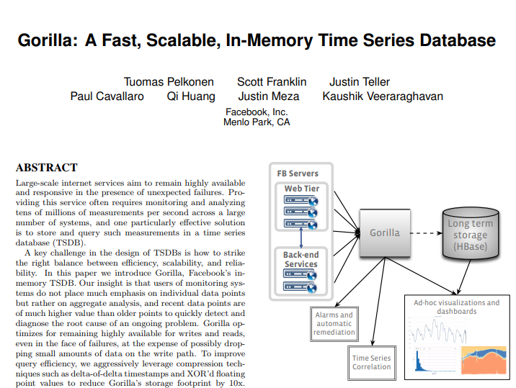

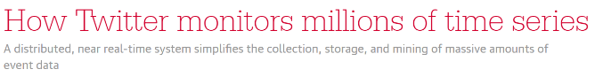
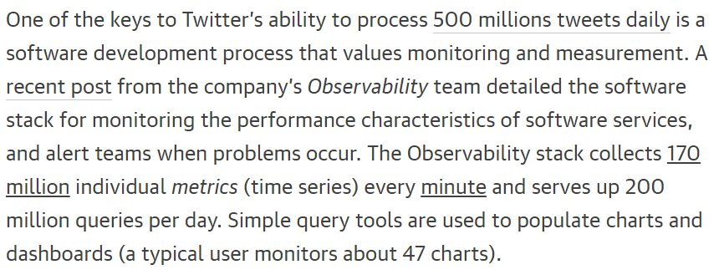
Planet Scale Monitoring Data Generated
“ Operating planet-scale, globally distributed cloud platforms requires accurate monitoring of the health and performance of systems which cannot be handled by traditional commercial solutions ”
Facebook uses Gorilla to stores up to 10 billion unique time series,1 trillion data points per day, and servers 18 million queries per minute.
Twitter monitoring and troubleshooting service handles more than 2.8 billion write requests per minute, stores 4.5 petabytes of time series data, and handles 25k query requests per minute.
Challenges for Huawei Cloud BU
State transition. Identify issues that emerge from a service updates and configuration change that result in a significant state transition
High availability. Even if a network partition disconnects different datacenters, systems within a datacenter should be able to write data to local machines and retrieve data on demand.
Writes domination. Support a write rate greater that tens of millions of data points each second.
Fault tolerance. Replicate all writes to multiple regions to survive the loss of any given datacenter or geographic region due to a disaster.

Slide 21
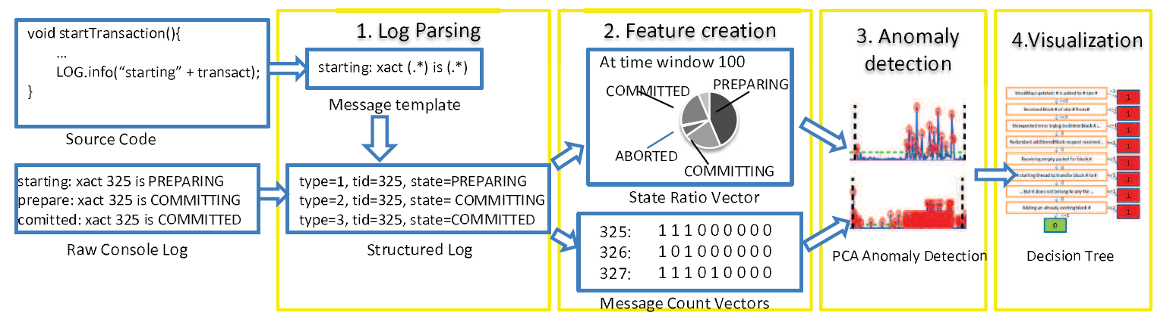
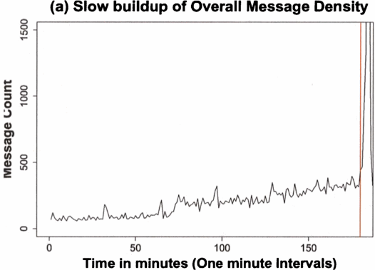
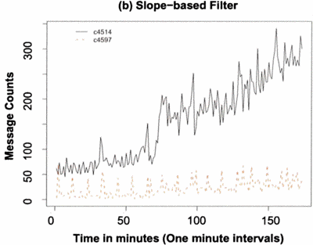

Application Log Analysis Error Rate Analysis
Event Density Anomalies
Integrate operations, running, monitoring, etc. logs
Similar to latency anomalies but we replace latency by the number of events generated over a time window or by a behavioral model
Use sudden and incremental level shift algorithms
Use outlier detection algorithms
Approach developed for Google infrastructure [3]
There is a period of time before/during a failure during which the event sources behaves anomalously (see [1]).
Classify the nature of failures
Permanent fault: remains active for a significant period of time (e.g.: damaged or incorrectly implemented component)
Transient fault: appears for a very short period of time and disappears (eg: soft error)
Intermittent (periodic) fault: appears, disappears, and reappears (eg: a parasitic signal emitted by a part of an electronic system disturbs another part during the operation)Transient
Problem
Problem
Failure foresight
[1] A log mining approach to failure analysis of enterprise telephony systems, Dependable Systems and Networks With FTCS and DCC, 2008. DSN 2008. IEEE International Conference on
[2] Google Four Golden Signals for Monitoring Distributed Systems
[3] Wei Xu, Ling Huang, Armando Fox, David Patterson, and Michael I. Jordan. 2009. Detecting large-scale system problems by mining console logs. In Proceedings of the ACM SIGOPS 22nd symposium on Operating systems principles (SOSP '09). ACM, New York, NY, USA, 117-132.

Slide 22
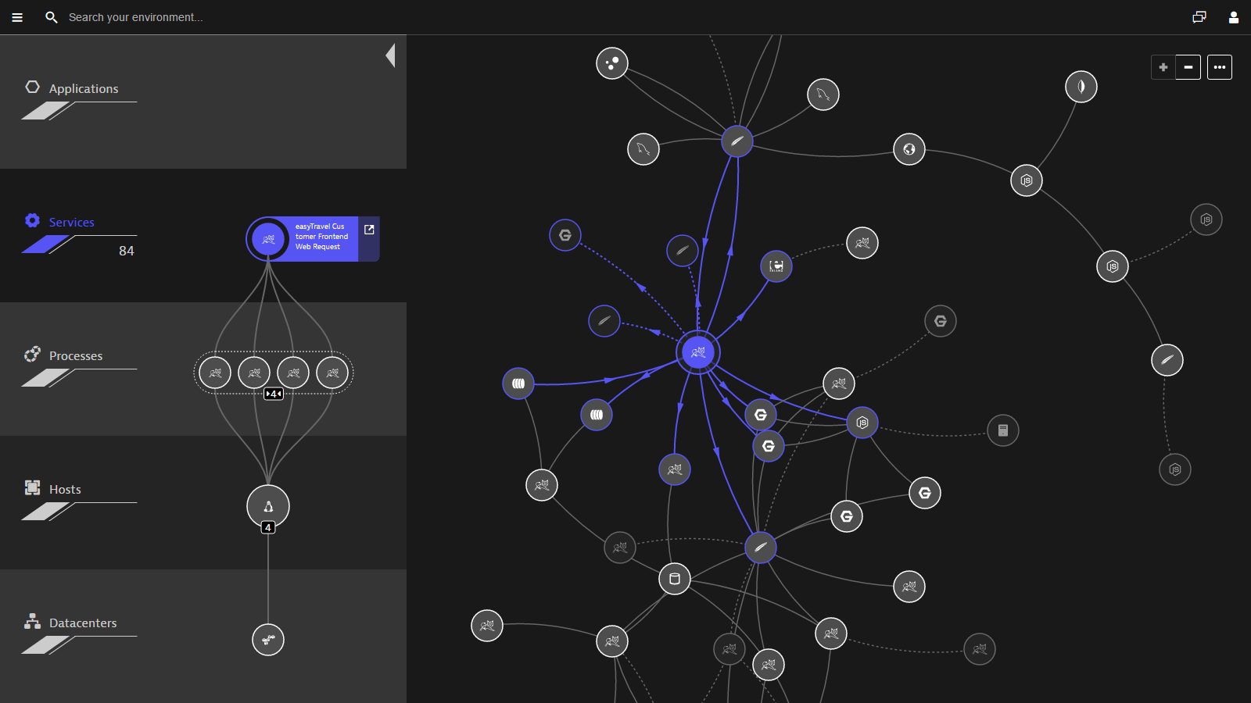
Topology Analysis Exploring Causality for Root Cause Analysis
How to build a topology service/knowledge graph to assist RCA using real-time traces and static CMDB data?
Topology Construction
Discover the dependencies between components (nova, controllers, hosts, services, etc.) using trace information and CMDB
Construct a graph with each node representing a component.
Since traces have correlation information between two components and timing information, establish causality.
Use Cases
Root Cause Analysis using topologies
Alarm deduplication using topologies
Service-to-service communication (Service Networks) analysis
Trace analysis and reliability
Dynatrace cloud infrastructure monitoring using topology models using CMDBs
Layers
Operation Layer. Nodes representing the operations which can be invoked
Service Layer. Nodes representing the major services of HC, e.g., ECS and OBS
Microservice Layer. Nodes of microservices supporting major services
Virtual Layer. This layer captures all software-defined entities in the datacenter such as virtual machines (VM), containers, load balancers, virtual networks.
Physical Layer. Physical hosts and associated system resources to which virtual entities are mapped, e.g., memory, disks, NICs, CPUs, etc.
Network Layer. ToR switches, routers, etc.
Infrastructure Layer. Racks, Data Centers, Region, AZ, etc.
Root Cause Analysis
Step 1. When a component fails, analyze the log-based behavior model, resource model, and other models of the faulty component that failed.
Step 2. Search the topology and find all the predecessors of the faulty component.
Step 3. Analyze the faulty components predecessors. Repeat Step 1.

